Slide 1
Regenstrief Institute’s Gopher CPOE System
2013 Update
Advances in CDS and Provider Collaboration
Jon Duke, Burke Mamlin, Doug Martin, Blaine Takesue

Slide 2

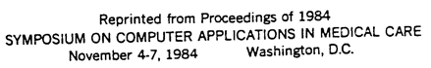
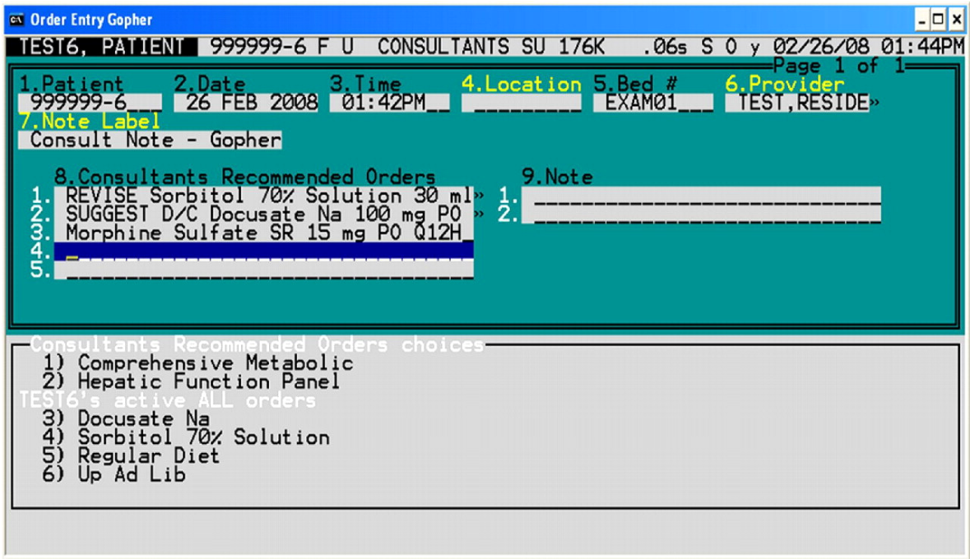
A Refresher on Gopher
Debuted in 1984

Slide 3
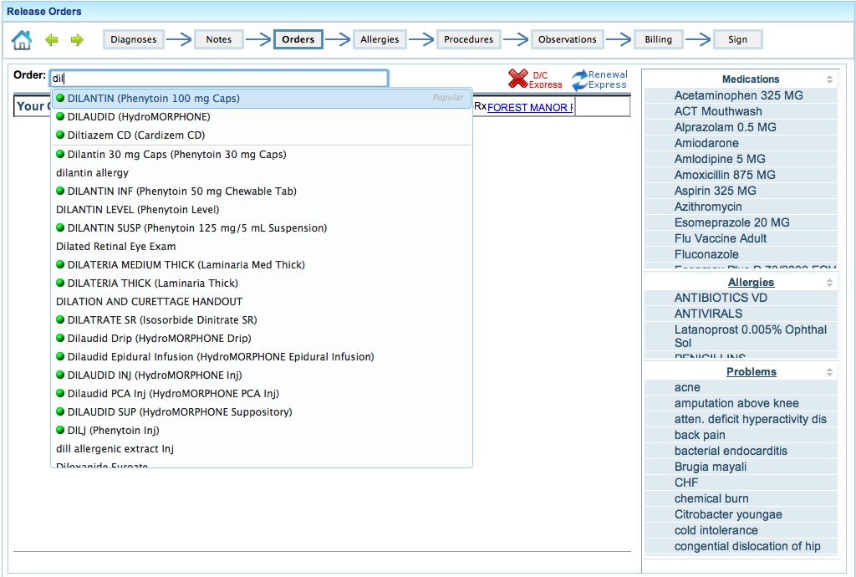
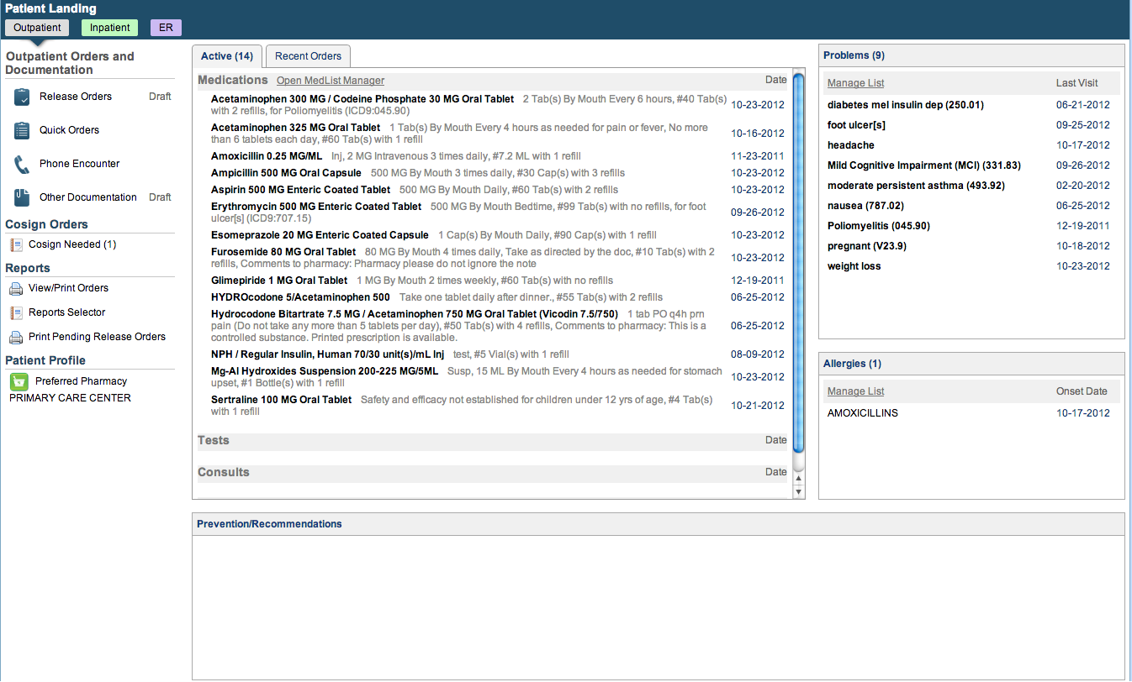
A Refresher on Gopher
Rebooted in 2010

Slide 4
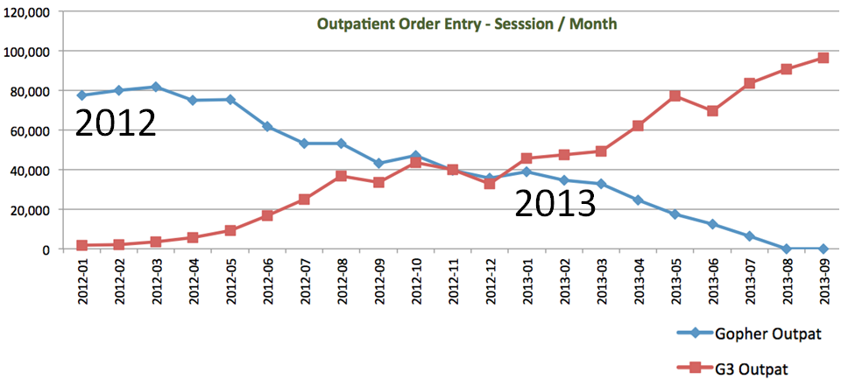
A Refresher on Gopher
Deployment 2012

Slide 5
Current Gopher Stats
Average 1100 users (450 physicians) per day
Used in 79 outpatient clinics, 335-bed inpatient hospital, and Emergency Dept
On average, users complete >7,000 order sessions daily on over 3,700 patients
65% outpatient
25% inpatient
10% ED

Slide 6
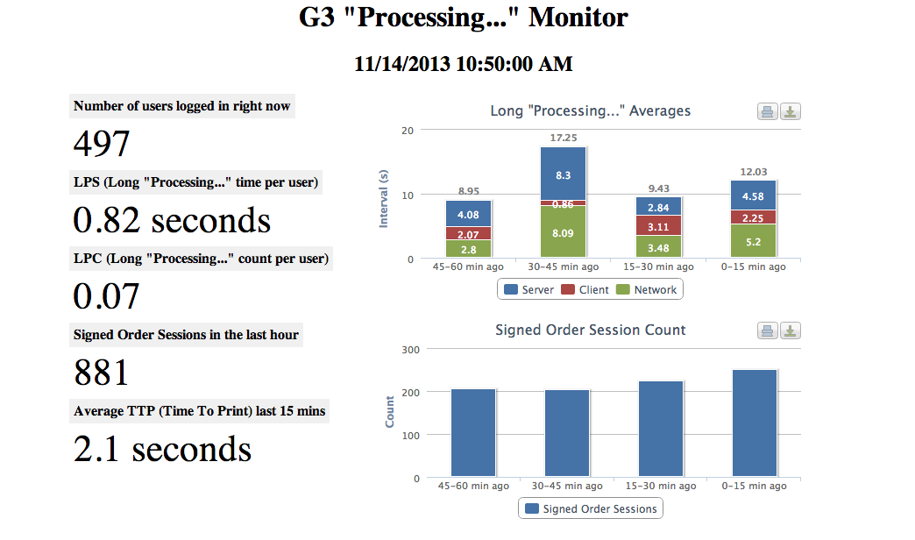
Gopher Performance Monitoring

Slide 7
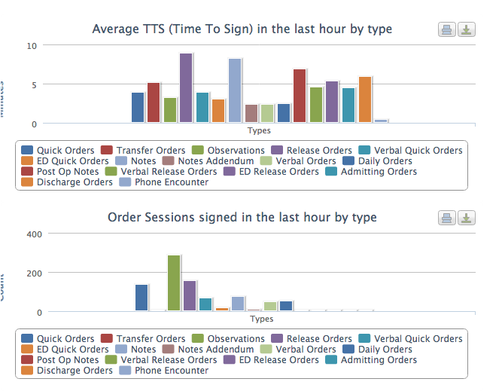
Gopher Performance Monitoring

Slide 8
Certifications
Meaningful Use
Stage 1 Certified
Stage 2 testing next month
Surescripts
10.6 certification in process

Slide 9
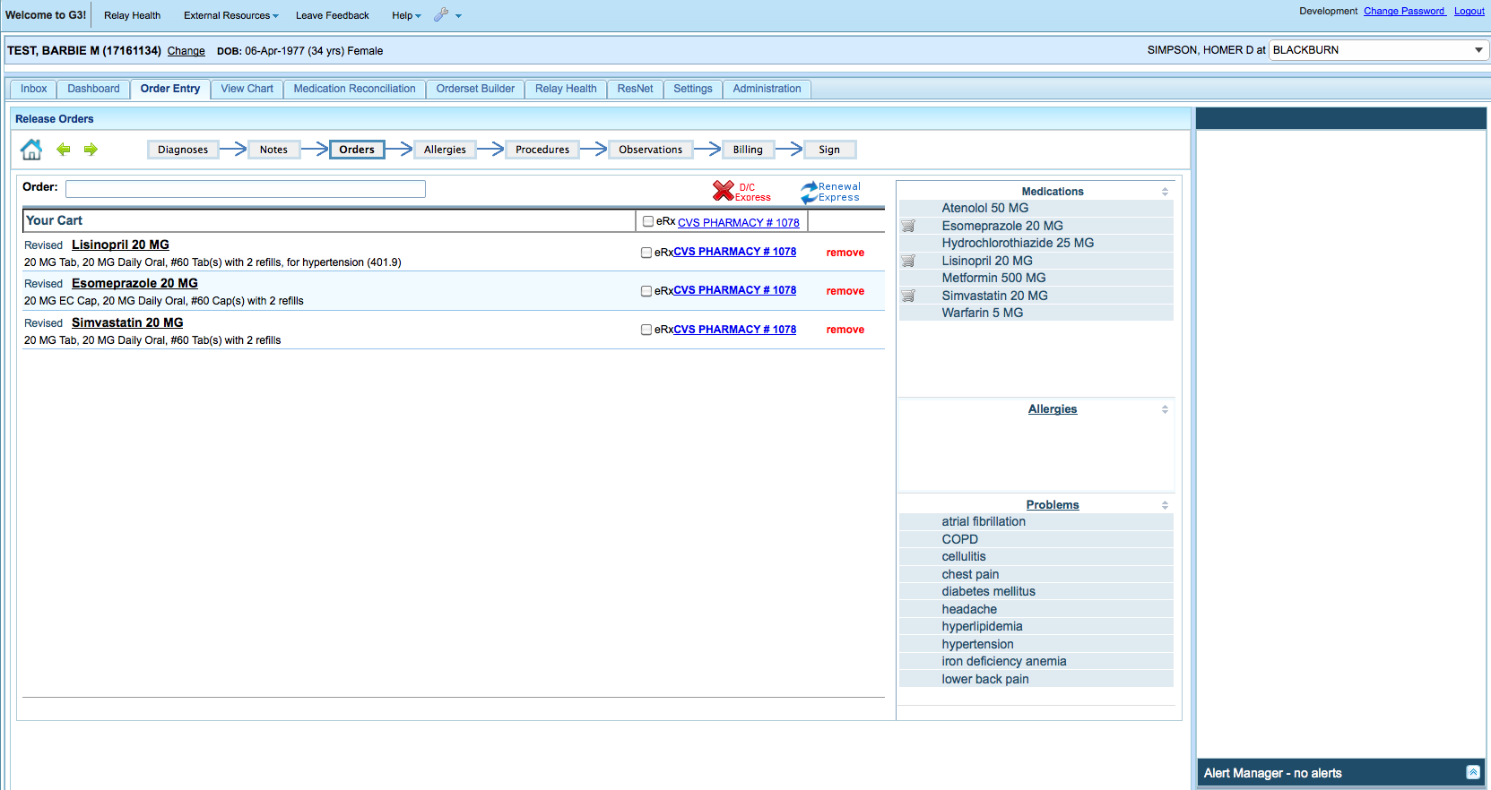
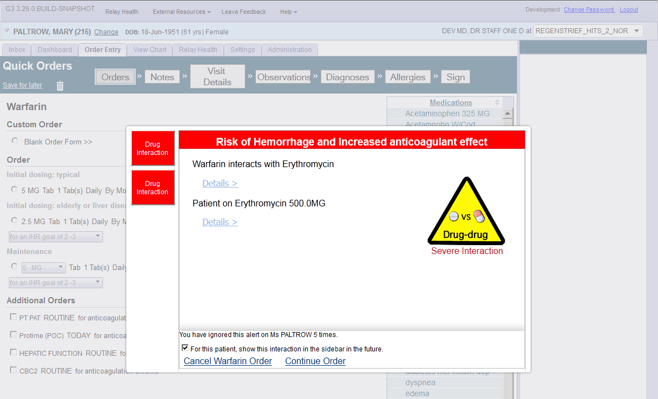
Things We Talked About Last Year
Alerting Zones and
Contextual Alerts
Alerts That Learn

Slide 10
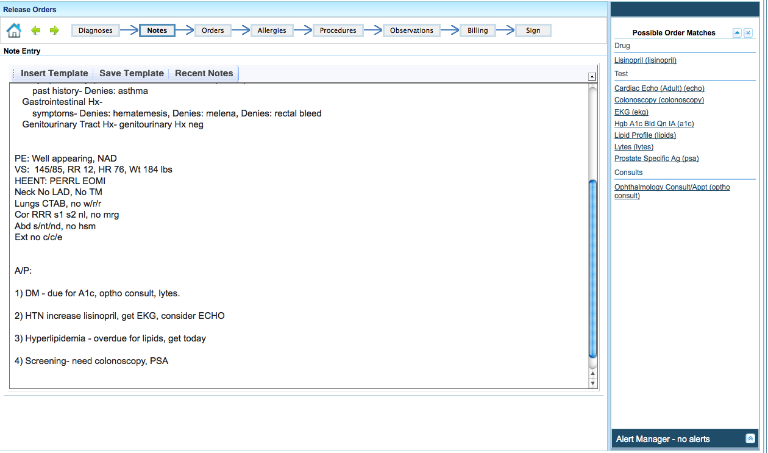
Things We Talked About Last Year
Real-Time
Natural Language Processing

Slide 11
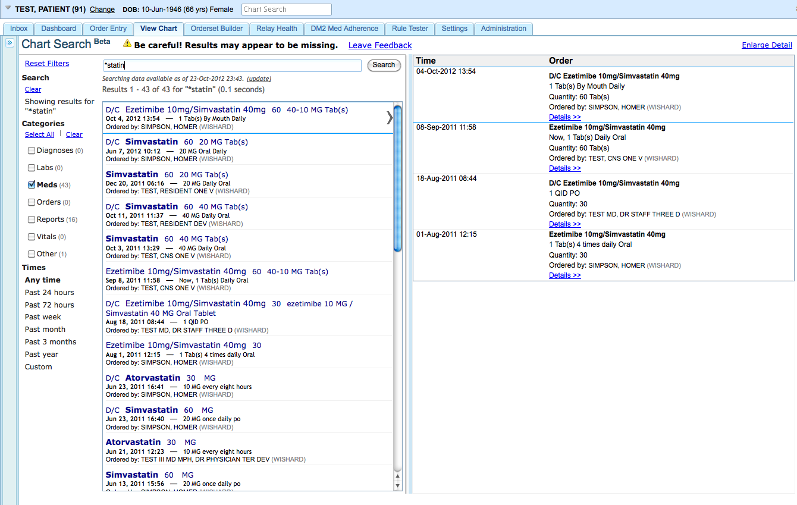
Things We Talked About Last Year
Google-y Chart Search

Slide 12
Today’s Demonstration
Advances in Clinical Decision Support
Preemptive and Persistent CDS
Advanced rule-authoring
Provider collaboration tools
Comment Wall
Collaborative Timeline
Enhancing clinical data review
Dynamic Notes
Linked Reports
Notes:
Clinical Decision Support / Order Entry
-- Pre-emptive alerts (also on Template)
-- Viewing recent results (Admission Order Menu Medical ICU)
-- ED quick orders (Weight based dosing automatically (use PEDS))
-- Med Rec for 999995 (Discharge Orders)
-- Demo NLP recognition
Improving Provider Collaboration (Two People)
Chat
Timeline – Use pt 989898, add some stuff, pull up timeline
Chart Search – Shared Comments and References / Links
Enhancing Chart Review / Search
Sparklines and batteries
Show NLP in reports (e.g., show potassium value)
Add Link to another report from your note
Research and Quality
RAVE – run through (possible local machine), create alert and show
NLP pipeline builder –
Blaine – open source and training EMR

Slide 13
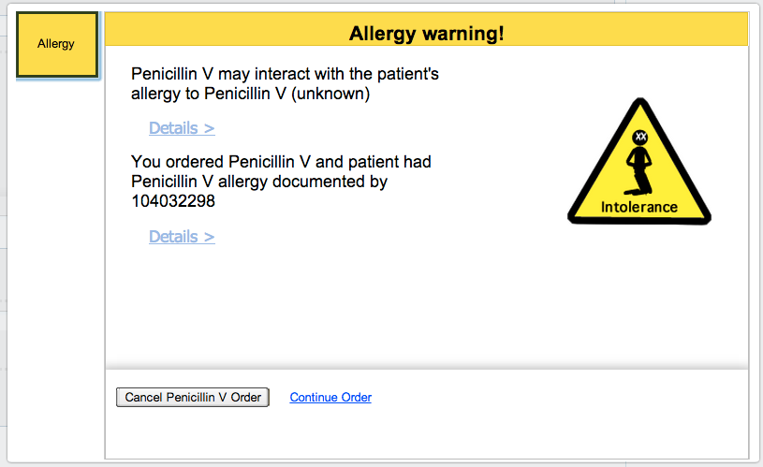
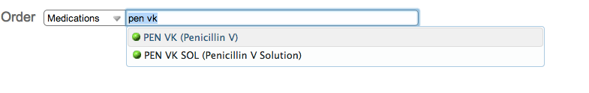
Traditional CDS

Slide 14
Preemptive CDS
Deliver warnings earlier in the decision making process
Drug safety alerts are still largely overridden, often inappropriately
Physicians are hard to persuade once they’ve committed to a treatment plan
Preemptive CDS seeks to catch physicians in the ‘pre-contemplation’ stage

Slide 15
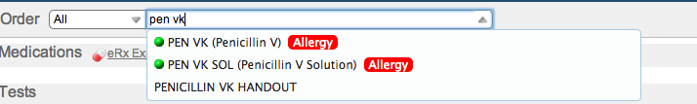
Preemptive CDS

Slide 16
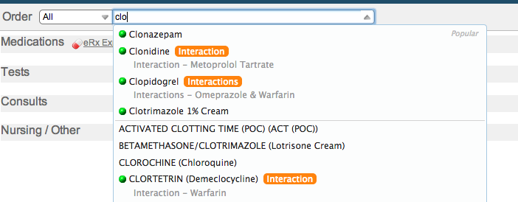
Preemptive CDS

Slide 17
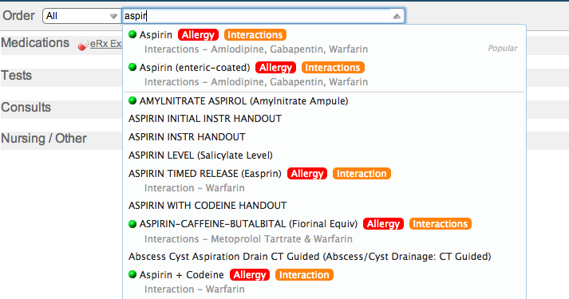
Preemptive CDS

Slide 18
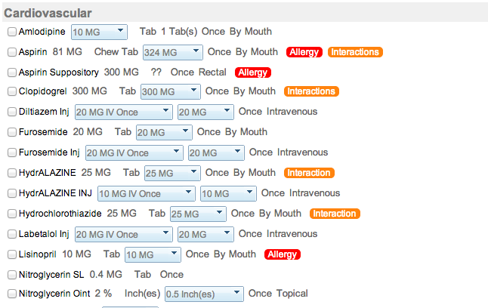
Preemptive CDS

Slide 19
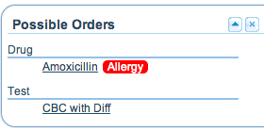
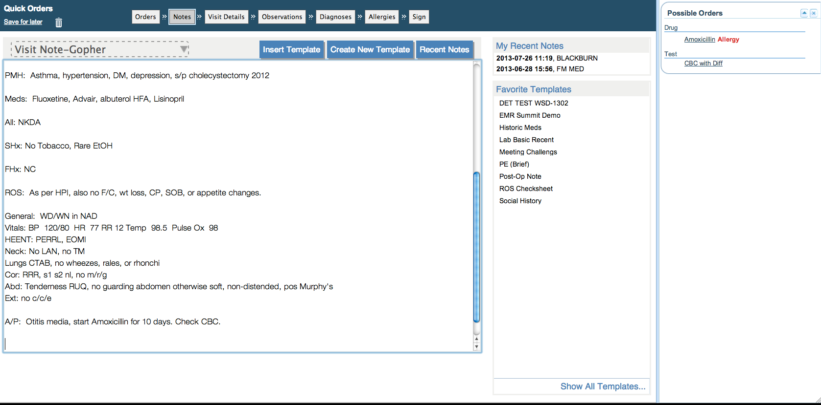
Preemptive CDS

Slide 20
Persistent CDS
Persist safety information even after alert has been overridden
Alerts are currently ‘out of sight, out of mind,’ disappearing immediately once overridden
Persisting warning information may give opportunity to reconsider the decision
Makes state of having overridden an alert more publicly visible
Notes:
Clinical Decision Support / Order Entry
-- Pre-emptive alerts (also on Template)
-- Viewing recent results (Admission Order Menu Medical ICU)
-- ED quick orders (Weight based dosing automatically (use PEDS))
-- Med Rec for 999995 (Discharge Orders)
-- Demo NLP recognition
Improving Provider Collaboration (Two People)
Chat
Timeline – Use pt 989898, add some stuff, pull up timeline
Chart Search – Shared Comments and References / Links
Enhancing Chart Review / Search
Sparklines and batteries
Show NLP in reports (e.g., show potassium value)
Add Link to another report from your note
Research and Quality
RAVE – run through (possible local machine), create alert and show
NLP pipeline builder –
Blaine – open source and training EMR

Slide 21
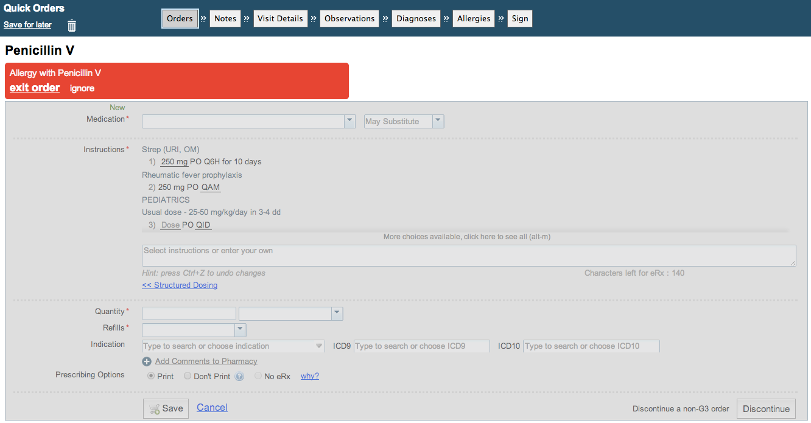


Slide 22
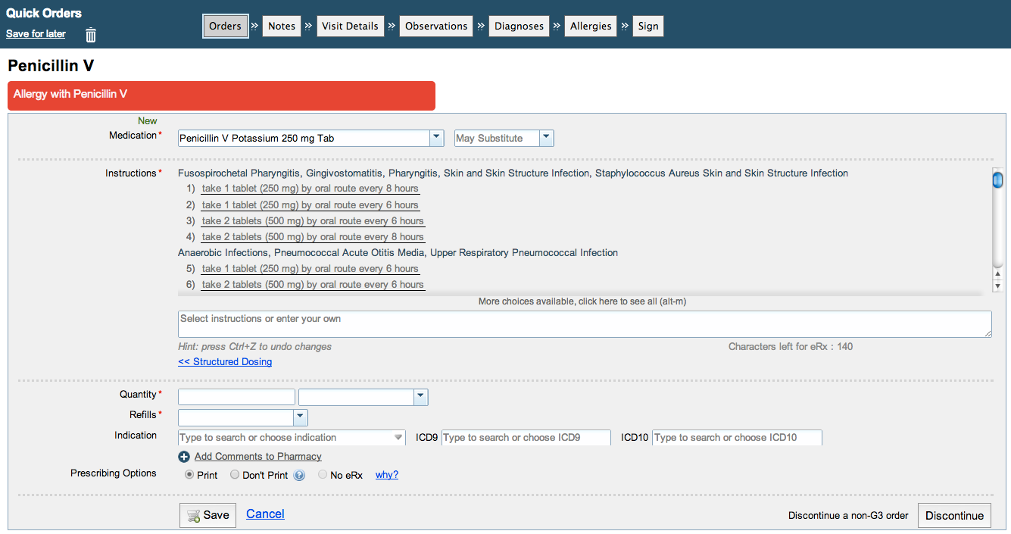
Persistent CDS

Slide 23
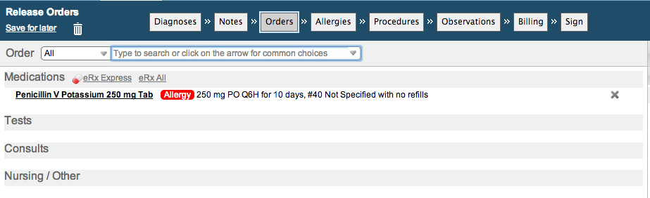
Persistent CDS

Slide 24
The RAVE
The Rule Authoring and Validation Environment is an advanced rule authoring tool
The RAVE is designed to facilitate a wide range of capabilities, including decision support, meaningful use, research, quality, and user customization of the system

Slide 25
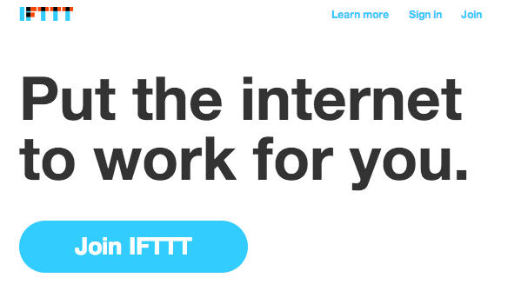

Slide 26
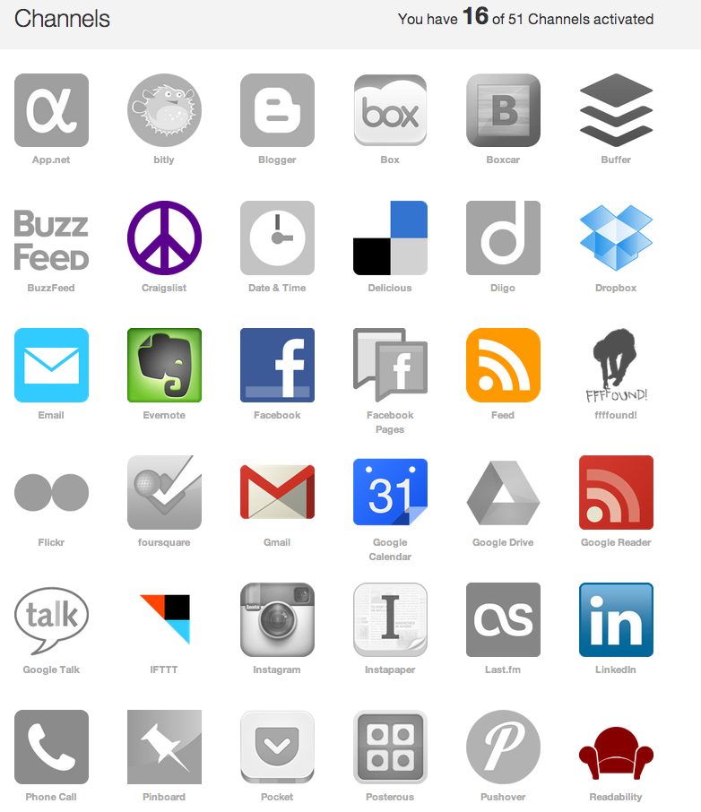

Slide 27
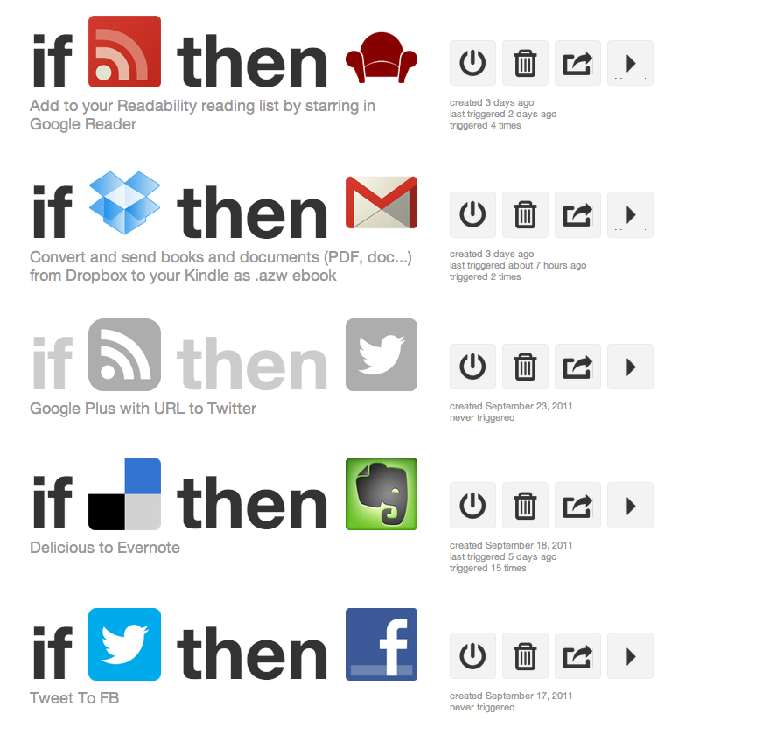
Great Artists Steal

Slide 28
RAVE = IFTTT for EMRs
Can mix and match channels to create a remarkable array of functionality without need for programmer intervention
Can write rules just for yourself or (with permission) your clinic, specialty, or all users
Rule syntax is generated automatically in a standard rules syntax (Drools)

Slide 29
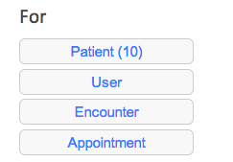
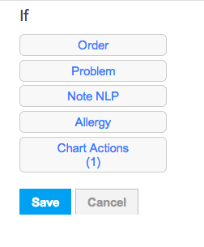
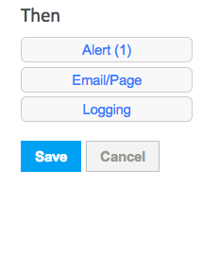
Patient
Alert
Observation
Chart Actions
Observation
HL7

Slide 30
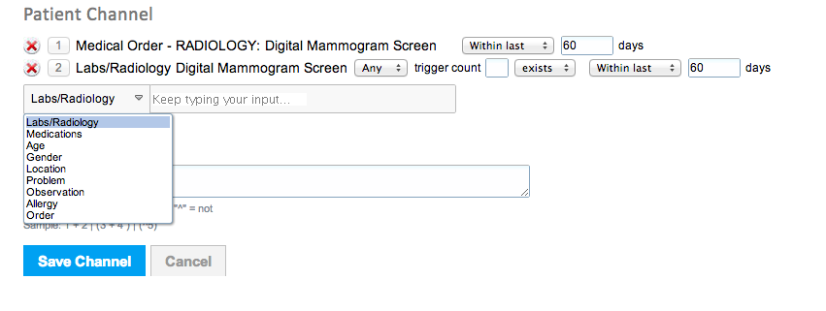
Patient
Alert
Observation
Chart Actions
Observation
HL7

Slide 31
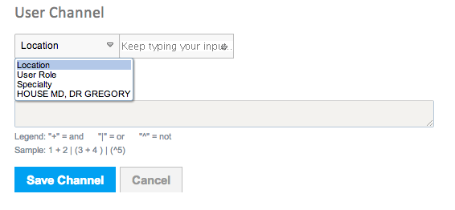
Patient
Alert
User
Observation
Chart Actions
Observation
HL7

Slide 32
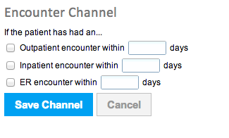
Patient
Alert
Encounter
Observation
Chart Actions
Observation
HL7

Slide 33
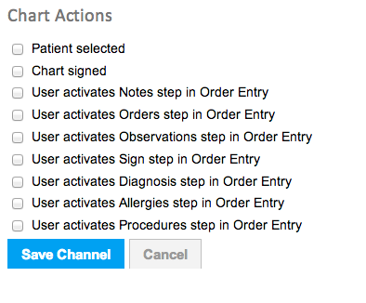
Patient
Alert
Encounter
Observation
Chart Actions
Observation
HL7

Slide 34
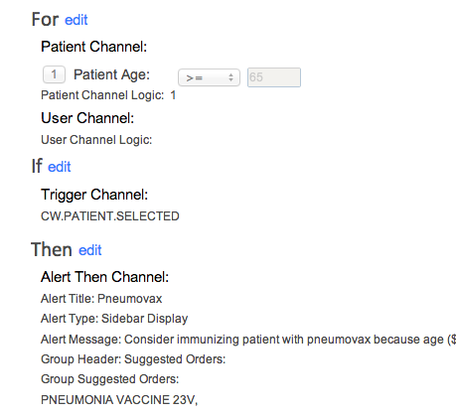
Rule Authoring and Validation Environment

Slide 35
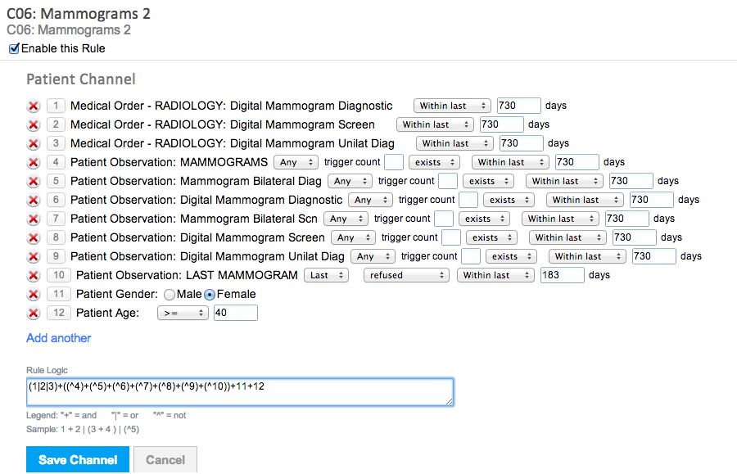

Slide 36
Patient
Alert
Observation
Chart Actions
Observation
HL7

Slide 37
Provider Collaboration
Goal is to support better communication across care providers
Synchronous and asynchronous
Facilitating patient care and physician learning
Notes:
Clinical Decision Support / Order Entry
-- Pre-emptive alerts (also on Template)
-- Viewing recent results (Admission Order Menu Medical ICU)
-- ED quick orders (Weight based dosing automatically (use PEDS))
-- Med Rec for 999995 (Discharge Orders)
-- Demo NLP recognition
Improving Provider Collaboration (Two People)
Chat
Timeline – Use pt 989898, add some stuff, pull up timeline
Chart Search – Shared Comments and References / Links
Enhancing Chart Review / Search
Sparklines and batteries
Show NLP in reports (e.g., show potassium value)
Add Link to another report from your note
Research and Quality
RAVE – run through (possible local machine), create alert and show
NLP pipeline builder –
Blaine – open source and training EMR

Slide 38
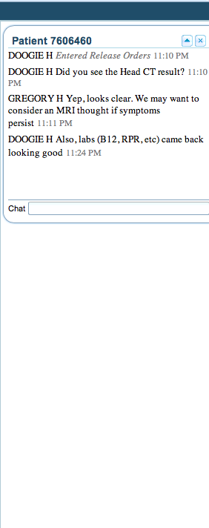
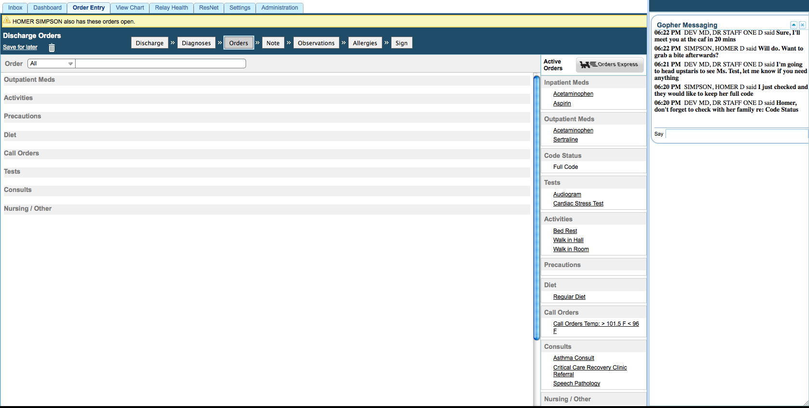
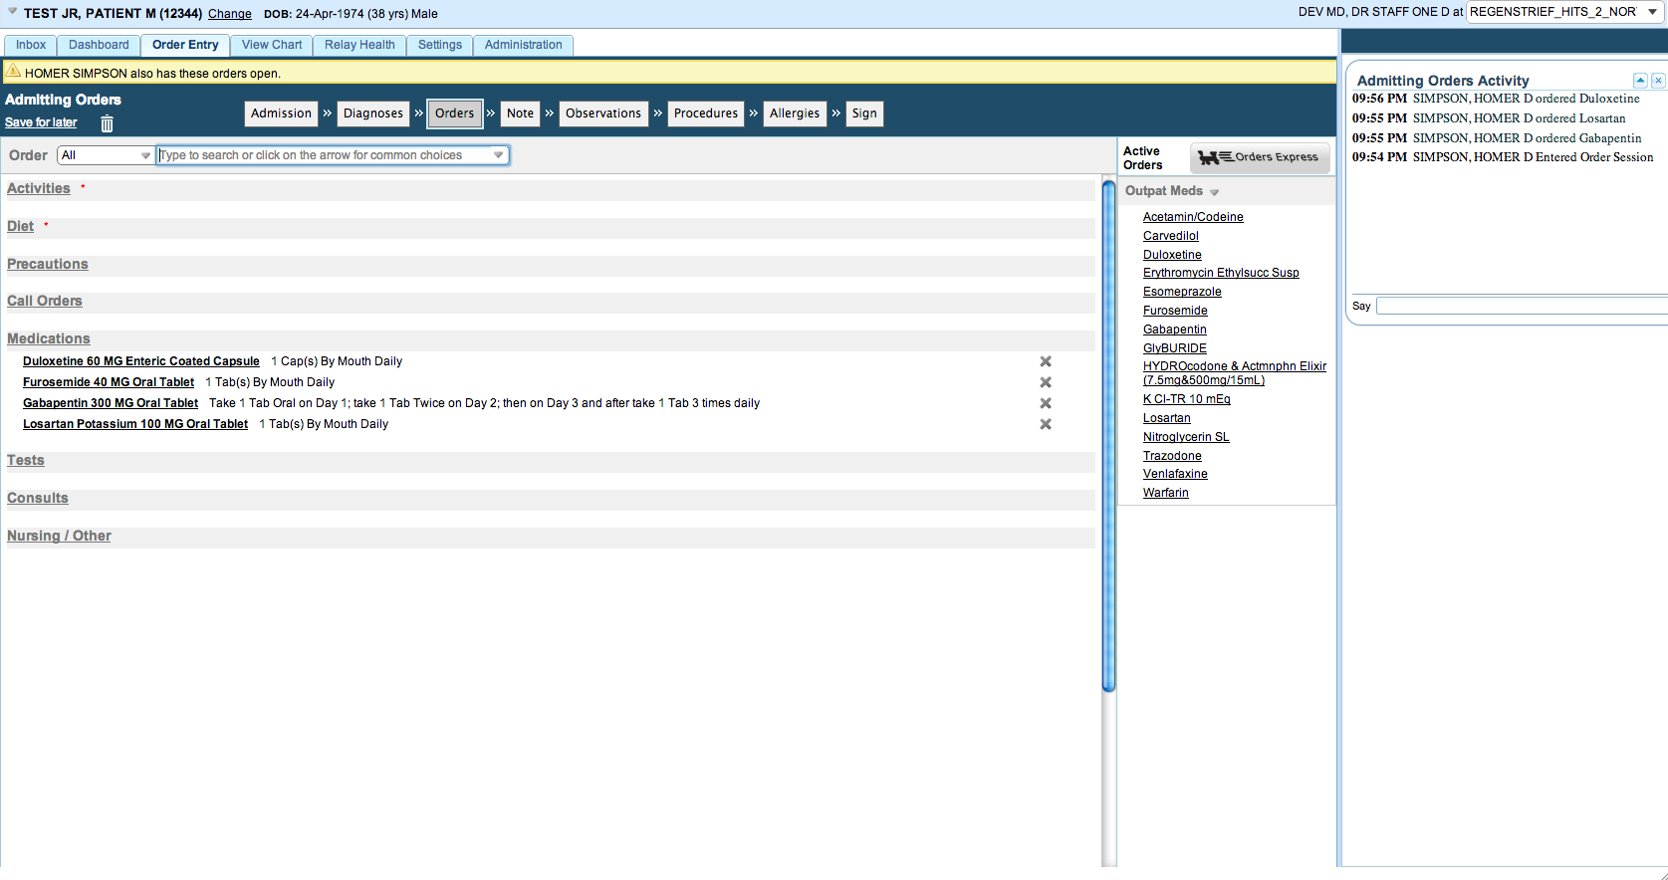
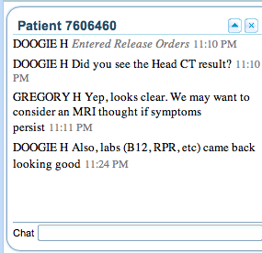
Real-Time Chat / Chart Activity Monitor

Slide 39
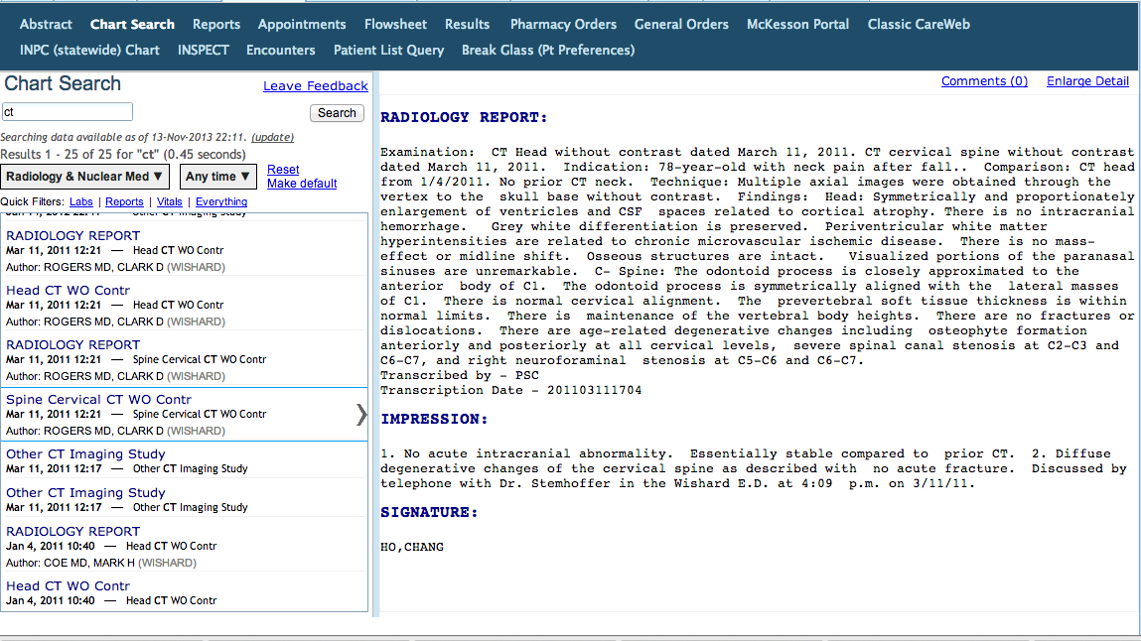
Comment ‘Wall’
Enables threaded commenting and discussion around any data element in the patient’s chart
Note: Production deployment of Comments pending liability review

Slide 40
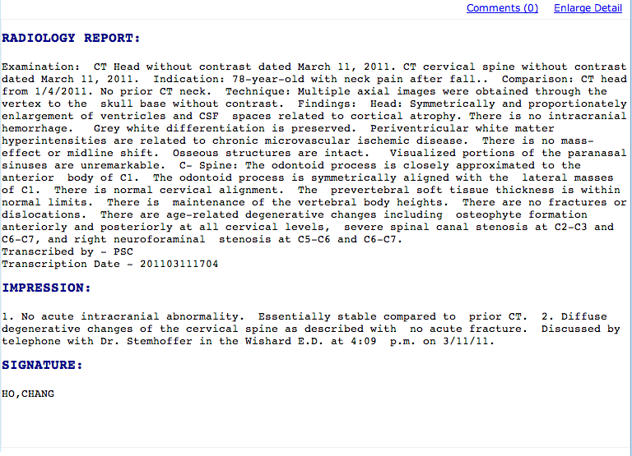

Slide 41
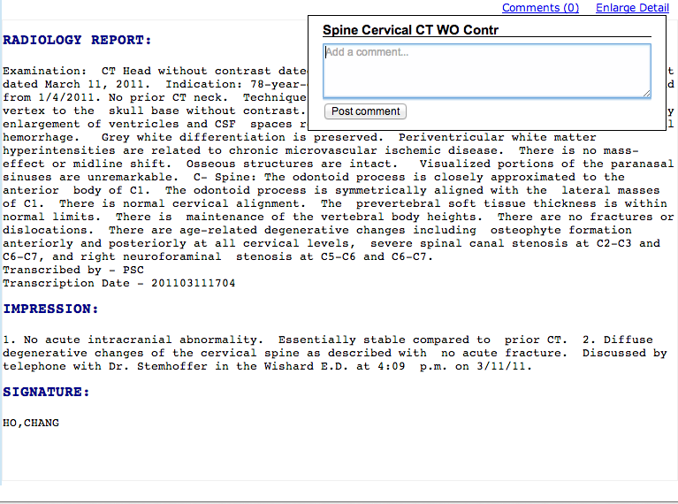

Slide 42
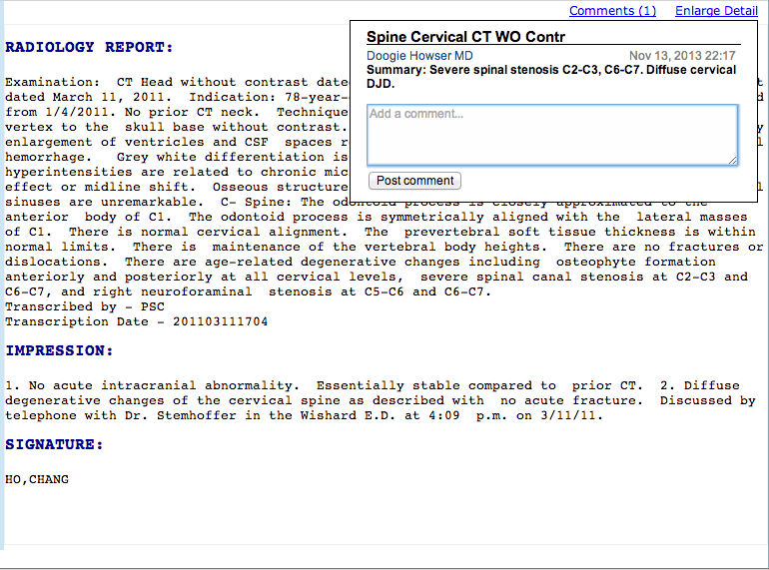

Slide 43
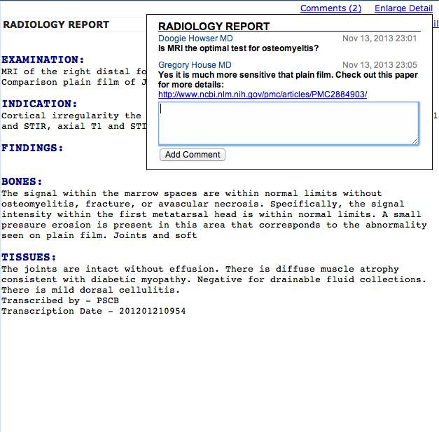
Comments

Slide 44
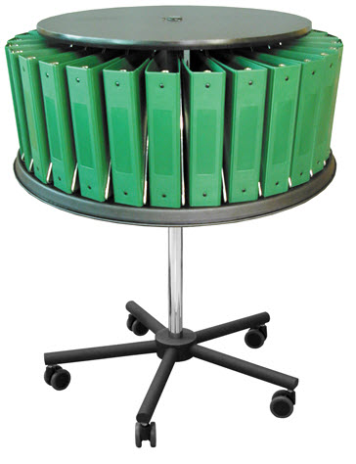

Slide 45
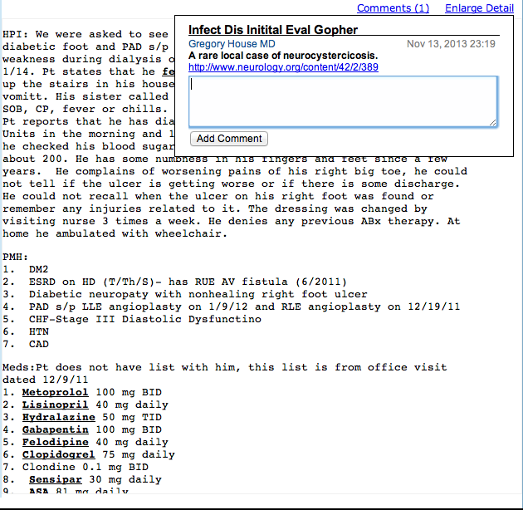

Slide 46
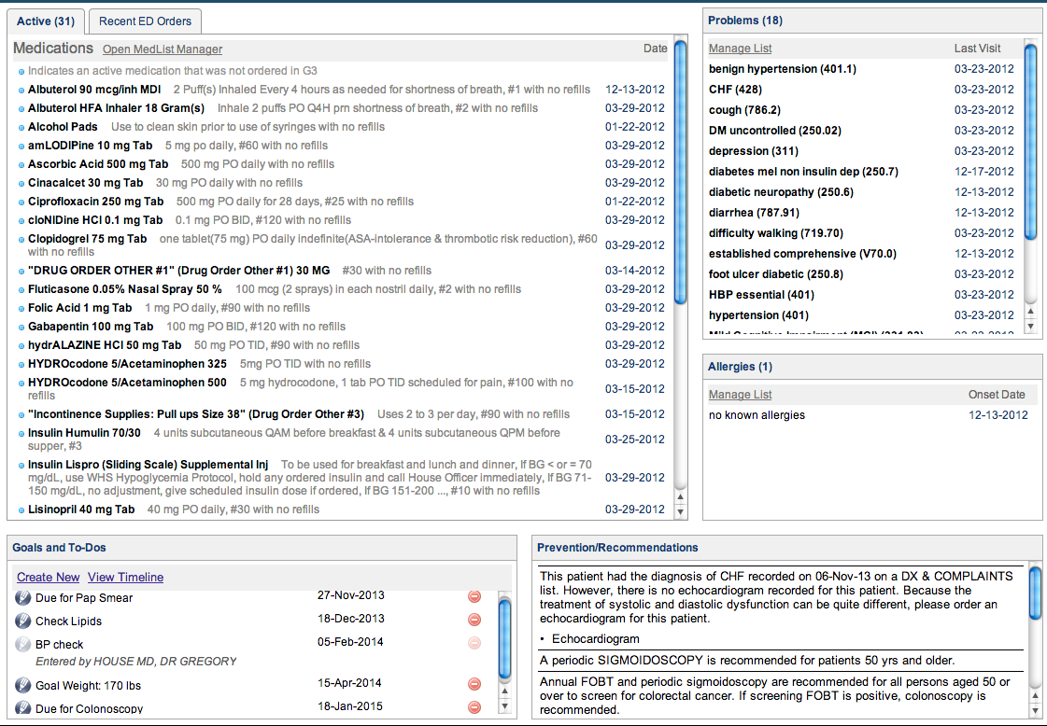
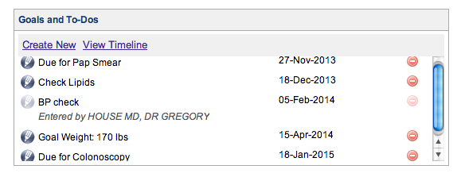
Collaborative Timeline
Notes:
Add back intro Timeline slide and bow up bottom

Slide 47
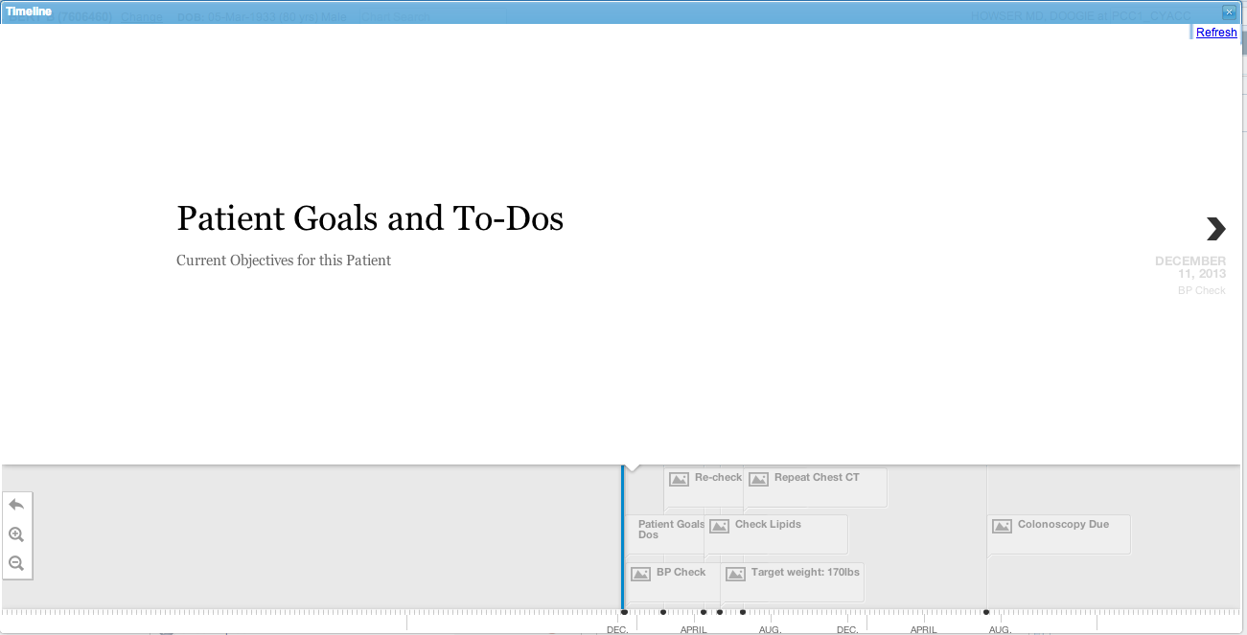
Visual Timeline

Slide 48
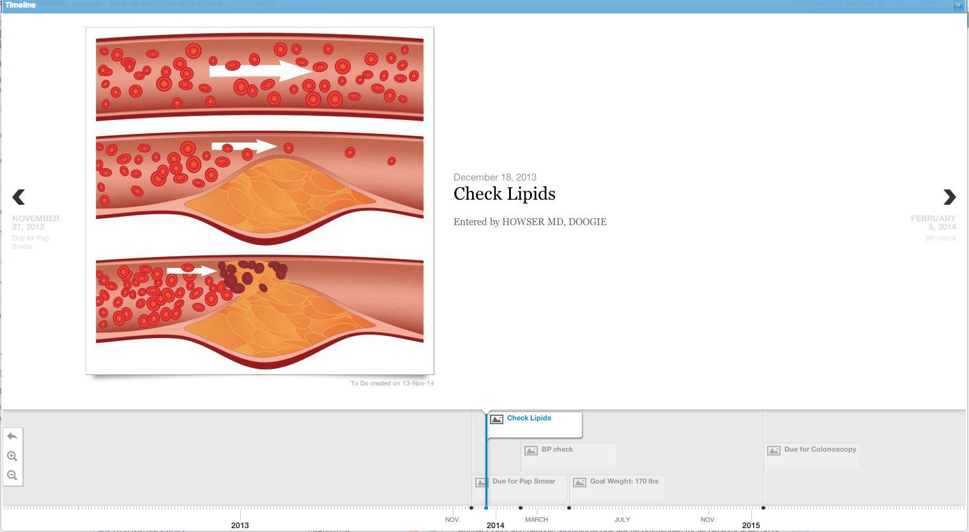
Visual Timeline

Slide 49
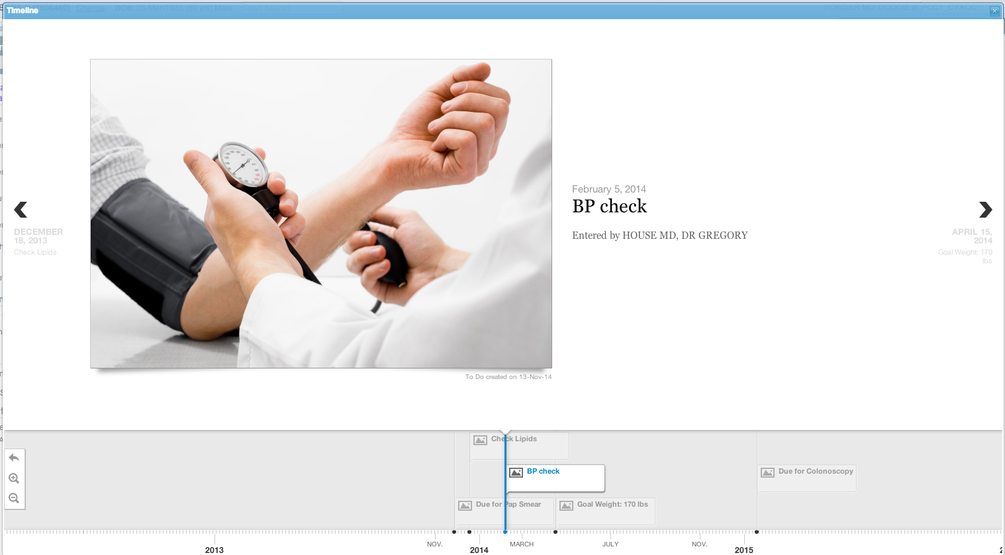
Optional Sharing Across Providers

Slide 50

Uses NLP to Match Images

Slide 51
Collaborative Timeline
Goal is to encourage providers to document specific objectives and tasks to be shared across the whole care team
Next phase is to develop subscriptions to allow providers to track changes in patient timeline and comments
Notes:
Clinical Decision Support / Order Entry
-- Pre-emptive alerts (also on Template)
-- Viewing recent results (Admission Order Menu Medical ICU)
-- ED quick orders (Weight based dosing automatically (use PEDS))
-- Med Rec for 999995 (Discharge Orders)
-- Demo NLP recognition
Improving Provider Collaboration (Two People)
Chat
Timeline – Use pt 989898, add some stuff, pull up timeline
Chart Search – Shared Comments and References / Links
Enhancing Chart Review / Search
Sparklines and batteries
Show NLP in reports (e.g., show potassium value)
Add Link to another report from your note
Research and Quality
RAVE – run through (possible local machine), create alert and show
NLP pipeline builder –
Blaine – open source and training EMR

Slide 52
Enhanced Data Review
Chart Search gave us speedy data lookup, but integrating data review into the clinical encounter remained a challenge
Current efforts aimed at better integrating information into the provider’s workflow
Mini Chart Search
Dynamic notes
Linked Reports
Notes:
Clinical Decision Support / Order Entry
-- Pre-emptive alerts (also on Template)
-- Viewing recent results (Admission Order Menu Medical ICU)
-- ED quick orders (Weight based dosing automatically (use PEDS))
-- Med Rec for 999995 (Discharge Orders)
-- Demo NLP recognition
Improving Provider Collaboration (Two People)
Chat
Timeline – Use pt 989898, add some stuff, pull up timeline
Chart Search – Shared Comments and References / Links
Enhancing Chart Review / Search
Sparklines and batteries
Show NLP in reports (e.g., show potassium value)
Add Link to another report from your note
Research and Quality
RAVE – run through (possible local machine), create alert and show
NLP pipeline builder –
Blaine – open source and training EMR

Slide 53

Chart Search

Slide 54

Enhanced Chart Search

Slide 55

Mini Chart Search

Slide 56


Slide 57


Slide 58


Dynamic Notes

Slide 59
Dynamic Notes
Dynamic notes is independent of author actions
Uses NLP to parse the note as you read it and detects clinical concepts
Set to show only lab tests currently
Retrieves most recent results for display on demand
Notes:
Clinical Decision Support / Order Entry
-- Pre-emptive alerts (also on Template)
-- Viewing recent results (Admission Order Menu Medical ICU)
-- ED quick orders (Weight based dosing automatically (use PEDS))
-- Med Rec for 999995 (Discharge Orders)
-- Demo NLP recognition
Improving Provider Collaboration (Two People)
Chat
Timeline – Use pt 989898, add some stuff, pull up timeline
Chart Search – Shared Comments and References / Links
Enhancing Chart Review / Search
Sparklines and batteries
Show NLP in reports (e.g., show potassium value)
Add Link to another report from your note
Research and Quality
RAVE – run through (possible local machine), create alert and show
NLP pipeline builder –
Blaine – open source and training EMR

Slide 60

Linked Reports

Slide 61

Linked Reports

Slide 62



Slide 63


Slide 64
Dynamic Notes and Linked Reports
Goal is to embed data within the chart in a form more natural to today’s users (e.g., web)
Combines automated and manual integration of relevant data
Notes:
Clinical Decision Support / Order Entry
-- Pre-emptive alerts (also on Template)
-- Viewing recent results (Admission Order Menu Medical ICU)
-- ED quick orders (Weight based dosing automatically (use PEDS))
-- Med Rec for 999995 (Discharge Orders)
-- Demo NLP recognition
Improving Provider Collaboration (Two People)
Chat
Timeline – Use pt 989898, add some stuff, pull up timeline
Chart Search – Shared Comments and References / Links
Enhancing Chart Review / Search
Sparklines and batteries
Show NLP in reports (e.g., show potassium value)
Add Link to another report from your note
Research and Quality
RAVE – run through (possible local machine), create alert and show
NLP pipeline builder –
Blaine – open source and training EMR

Slide 65
Demonstration
Notes:
https://careweb-demo.regenstrief.org/CareWebDemo/

Slide 66
Open Source
Regenstrief supports open source development
The framework underlying the new Gopher has recently been released open source
carewebframework.org
github
The full CPOE is not yet available open source but we are working towards a deployable version

Slide 67
AMA - Accelerating Change in Medical Education (ACE)
Problem - Gap between medical education and medical practice is widening
Goal - Developing and promote new methods for teaching (educational decision support) and expose students to real-world informatics platforms
IU project will create a teaching EMR (tEMR)
Uses the Gopher platform
Includes panel of de-identified patients
Incorporates learning modules using real data

Slide 68

tEMR Infrastructure
Teaching EMR
tEMR
Computer Order Entry System
Gopher
“Thin” Gopher
Patient Database
Teaching database
10,000+ patients
INPC
Staging system
De-identifies data
Synchronizes data

Slide 69
Questions?
jonduke@regenstrief.org
bmamlin@regenstrief.org
btakesue@regenstrief.org
Regenstrief is hiring for faculty positions and fellowships in Biomedical Informatics. Contact schleyer@regenstrief.org for more information.

